Slide 1

IPL innings score predictor

Slide 2
AGENDA
Introduction
Problem Statement
Methodology
Results
References

Slide 3
Introduction
Navigating the future

Slide 4
Objectives & significance
Predictive Modeling: Develop accurate models to forecast first inning scores in IPL matches based on historical data of scores and team compositions.
Performance Analysis: Analyze team and player performance trends to identify factors influencing first inning scores, such as batting order, venue conditions, and opponent strength.
Pattern Identification: Identify recurring patterns and correlations in the data to uncover insights that can inform strategic decisions for teams and coaches.

Slide 5
Objectives & significance
Model Validation: Validate the predictive models using cross-validation techniques and assess their reliability in accurately predicting first inning scores across different seasons and match conditions.
Feature Engineering: Explore and engineer relevant features from the dataset, such as player statistics, match venues, and team dynamics, to enhance the predictive power of the models.

Slide 6

Problem Statement
Unlocking new horizons

Slide 7
Background
The Indian Premier League (IPL) is one of the most popular and competitive cricket tournaments globally, attracting millions of fans and enthusiasts every year. In IPL matches, the first innings score plays a crucial role in determining the outcome of the game. Predicting the first innings score accurately can provide teams, coaches, fans, and betting enthusiasts with valuable insights and a competitive edge.

Slide 8
Problem Description
Develop a machine learning model that accurately predicts the first innings score of IPL matches based on historical match data, team compositions, player statistics, venue conditions, and other relevant factors.

Slide 9
dataset
The dataset consists of historical IPL match data, including features such as team names, player statistics (e.g., batting average, strike rate), venue details, toss outcome, and match results. The target variable is the total runs scored by the batting team in the first innings of each match.
Information provided by this dataset:
DATE
VENUE
TEAM
BATSMEN
BOWLER
RUNS
WICKET
OVERS

Slide 10
Schematic diagram
P1
Exploring The Dataset
P2
P3
Data Preprocessing
P4
Data cleaning
P5
Predictions
Model Building

Slide 11
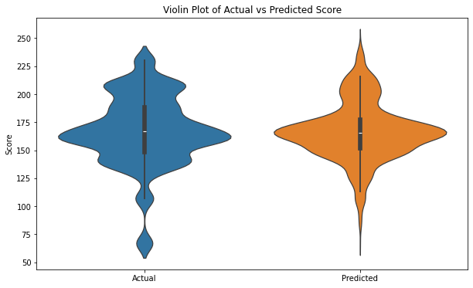
Eda

Slide 12
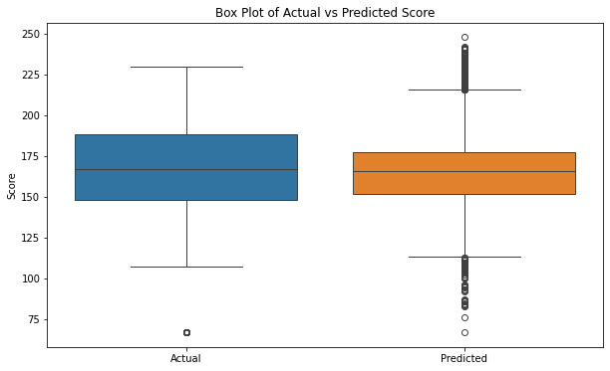
Eda

Slide 13

Results

Slide 14
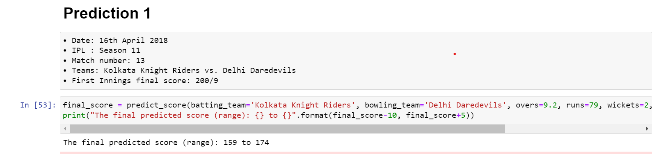

Slide 15
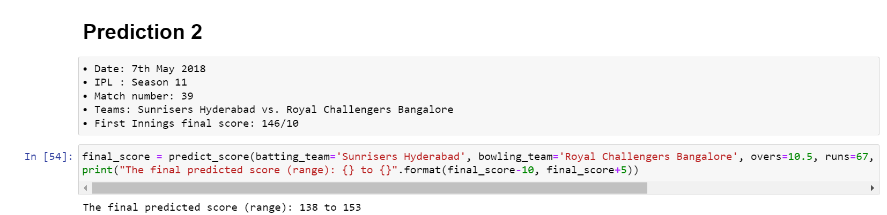

Slide 16
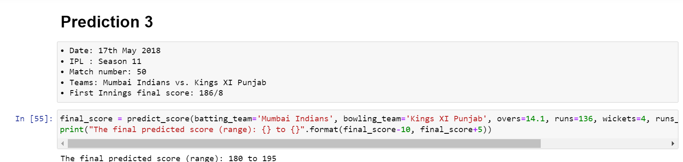

Slide 17
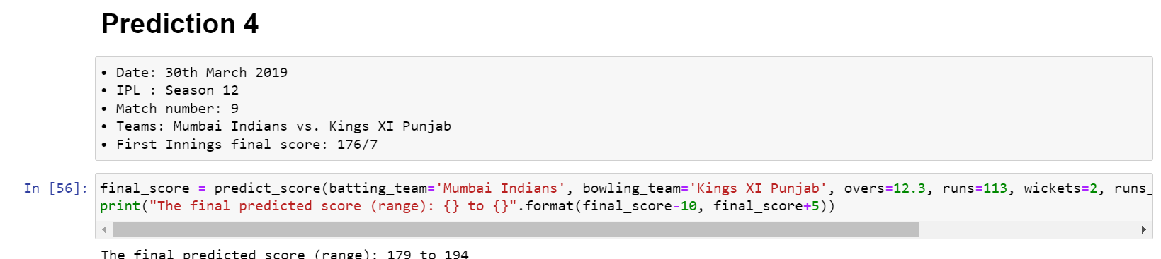

Slide 18
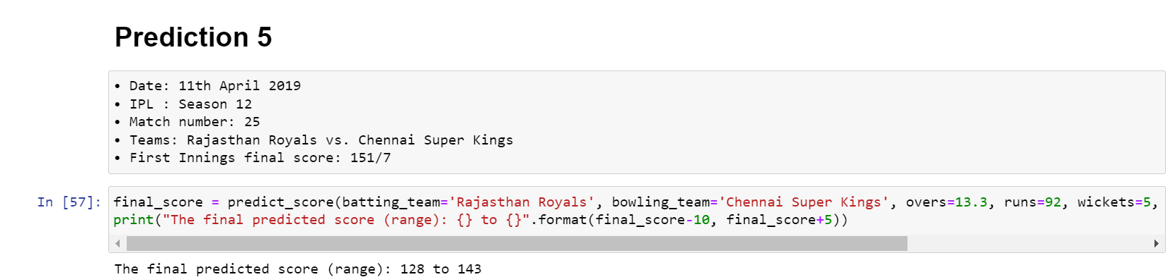

Slide 19
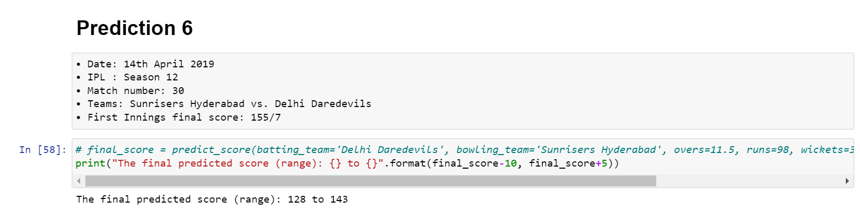

Slide 20
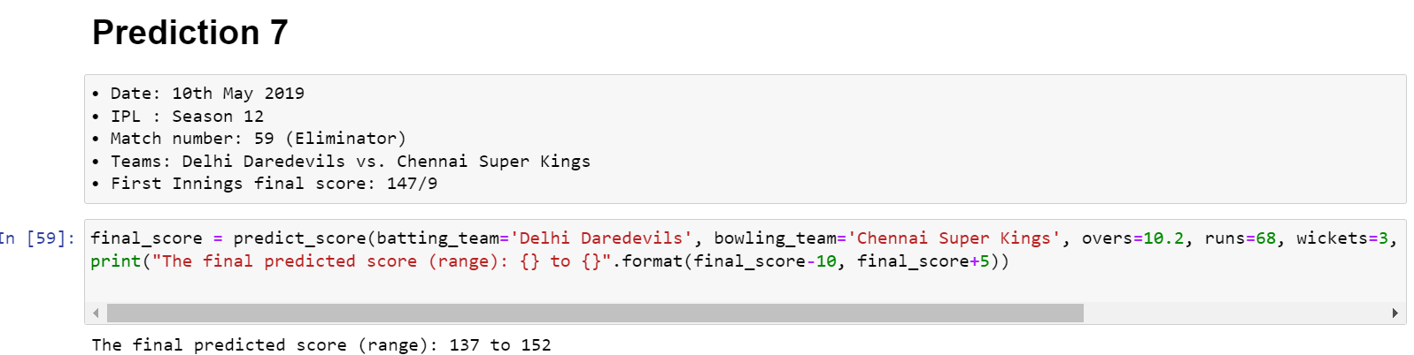

Slide 21
Thank you

